Slide 1
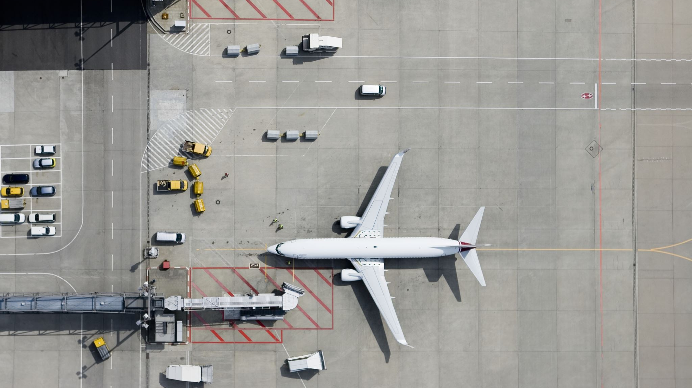
JFK Airport Taxi Out Times
Saqif Khan

Slide 2
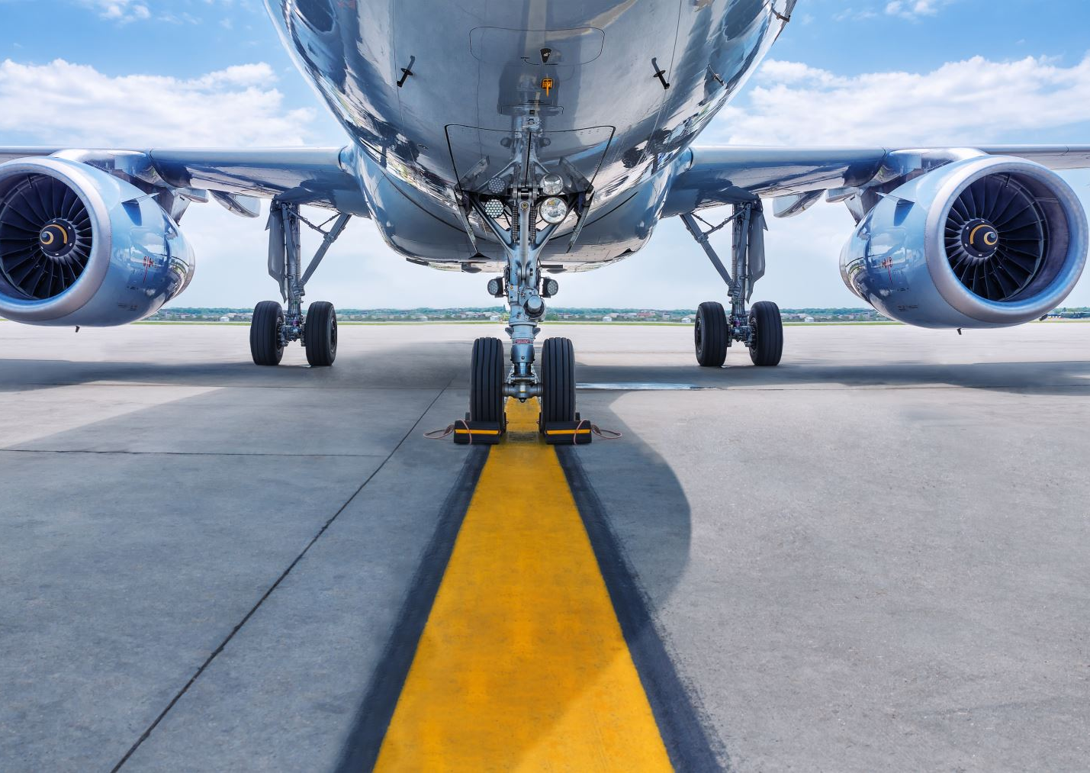
What is Taxi Out Time
The time taken from when the plane doors close until when the plane is on the runway ready for takeoff.

Slide 3
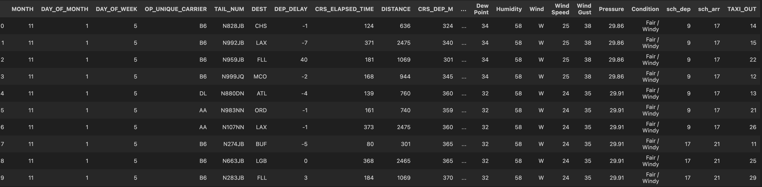
The data at hand
Using the function data.head(10) we can get a sample representative.
From the table you can see a few columns that could possibly affect Taxi Out times.

Slide 4
Which variables could affect Taxi Out time
Logically thinking we could possibly say:
Weather Conditions:
If the weather is clear
If weather is snowy/icy
If the weather is rainy
Wind, Wind Speed and Wind Gust:
If the winds speeds are too high for example, planes may have to wait for a time the wind slows down to be cleared for takeoff
Wind gust, how strong the gusts of winds lasting and how frequently could affect takeoff

Slide 5
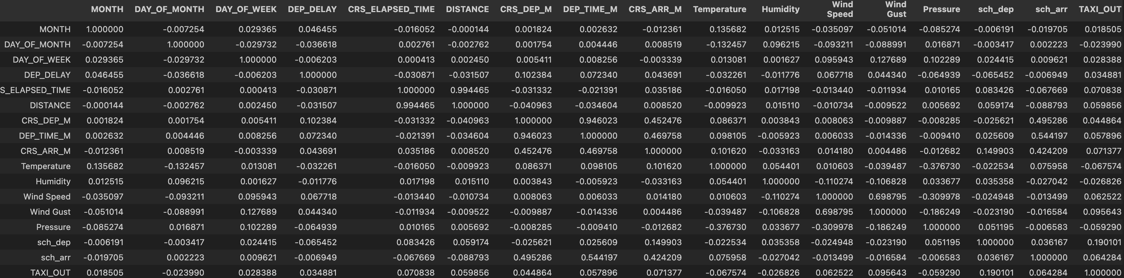
Exploring the correlation
Using a correlation matrix, we can see which factors correlate with Taxi Out time:

Slide 6
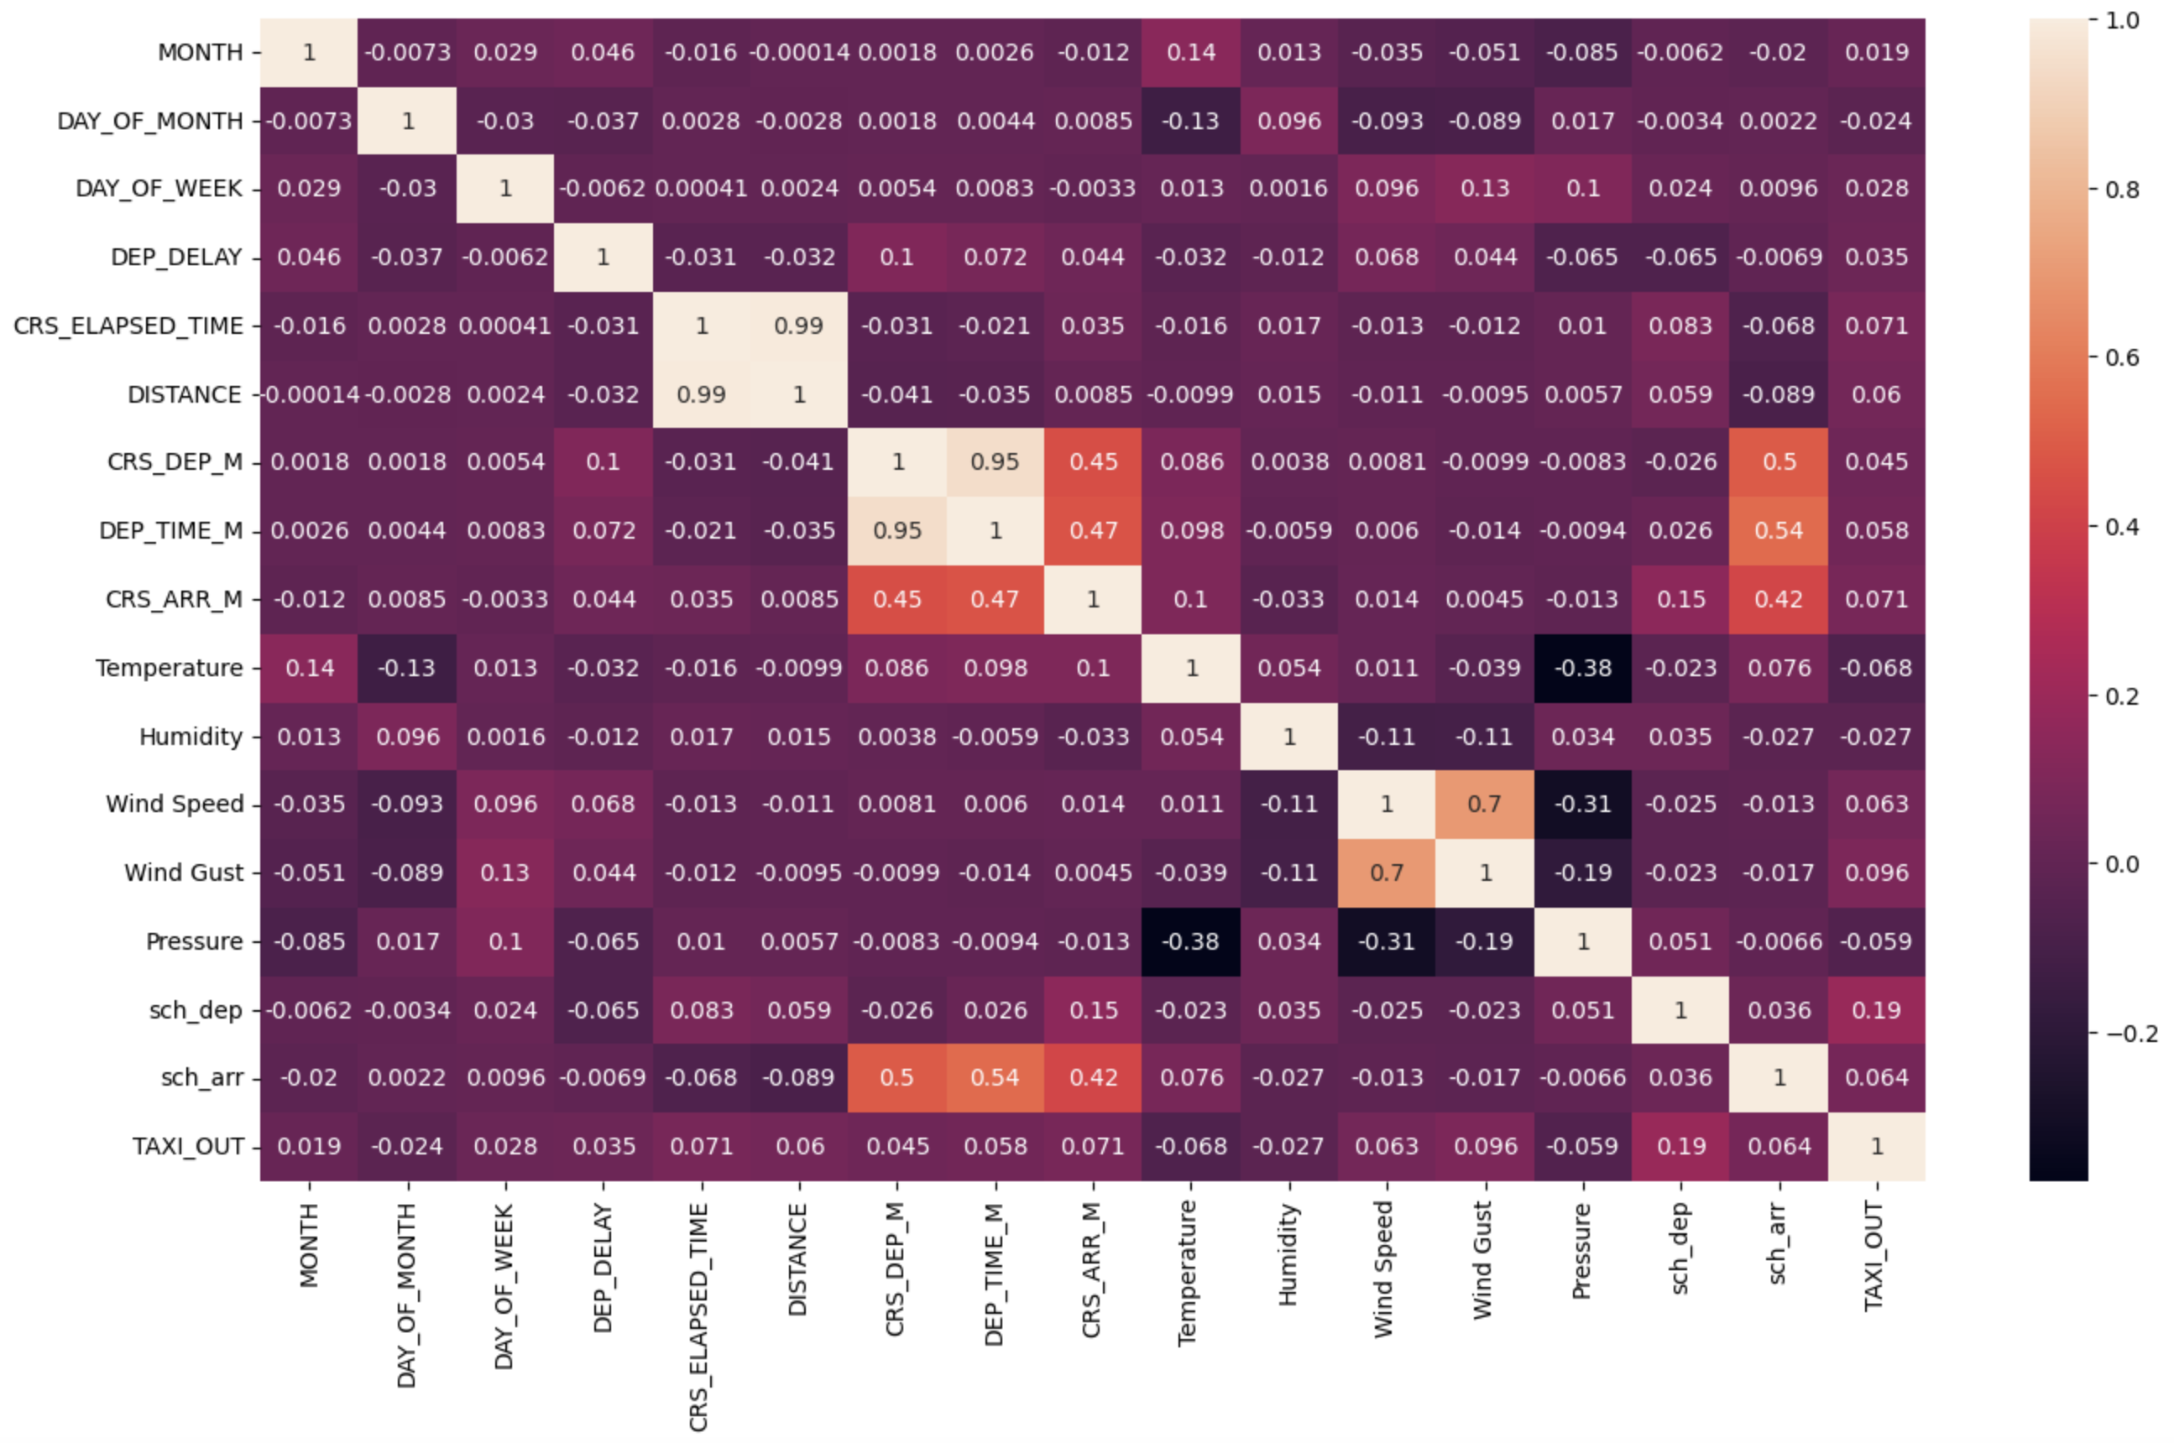
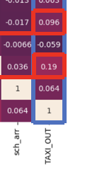
Heatmap
With the use of a heatmap, we can clearly visualize the correlations:
We can see that the Taxi out correlates mainly with:
Sch_dep (scheduled departure) with a positive correlation of 0.19
Wind Gust with a positive correlation of 0.096

Slide 7
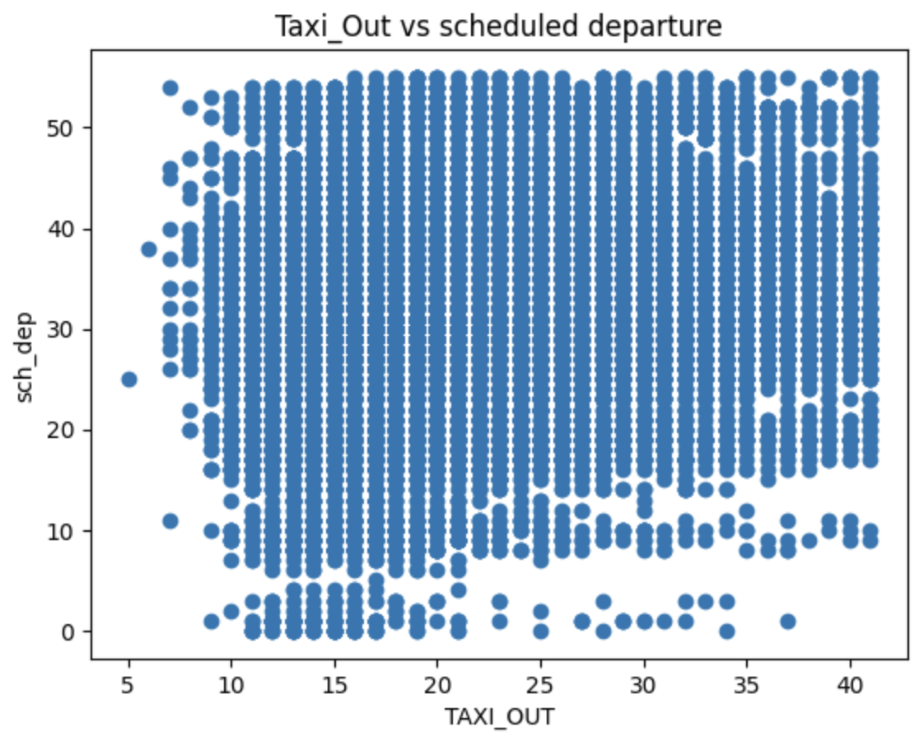
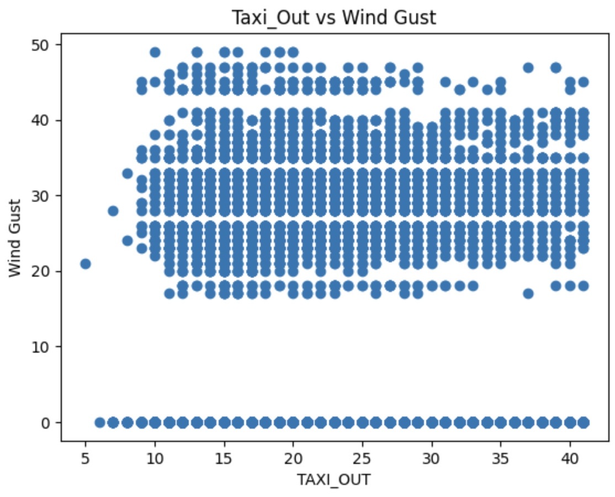
Scatter plots depicting correlation

Slide 8
Creating a machine learning model to predict Taxi_Out
Independent variables, x :
Sch_dep
Wind Gust
Dependent variable, y :
Taxi_Out
Using these data, we split the data into section :
80% of the data was used for training purposes
20% of the data was used for testing purposes

Slide 9
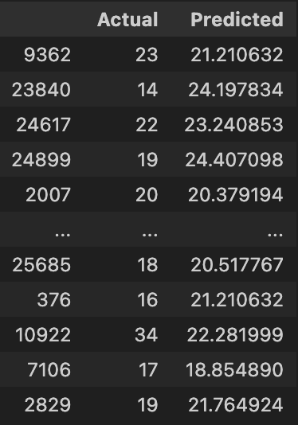
Using Linear Regression
Linear regression was used to make predictions of Taxi_Out time :
The predictions, although seem close for some, for majority are very far off.
This indicates the correlation between Taxi_Out with sch_dep and Wind Gust is very poor.
This can be shown with the R2 score

Slide 10
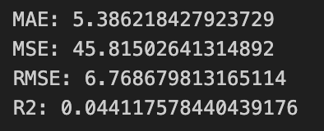
Using Linear Regression
The R2 Score for the predictive model shows how accurate this model is at predicting Taxi_Out time.
The R² Score achieved was 0.0441
This translates to an accuracy of 4.41%

Slide 11
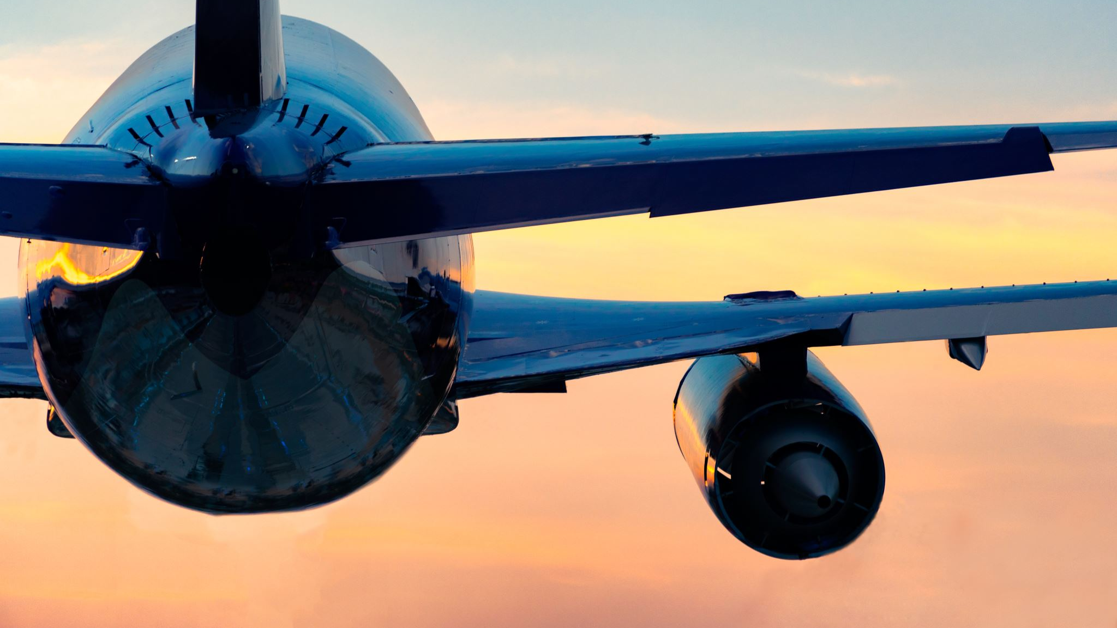
Thank you for listening

